Slide 1
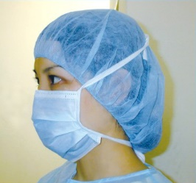

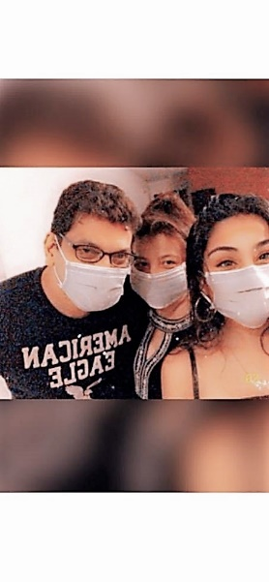
SUPPORT20
By Marguerite Aluwihare
A personal protective equipment range from high quality face masks, surgical & isolation gowns, protective suits to gloves, face shields, bouffant caps, beard covers & shoe covers

Slide 2
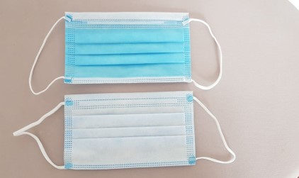
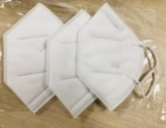
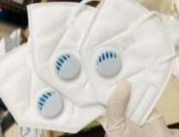
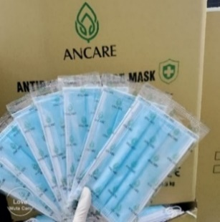
Face Masks * 3 layer /4 layer non-sterile face masks, 95%, 98%, 99% Bacterial filtration efficacy & PFE * 3 layer/4 layer sterile medical masks @ 99% BFE, PFE * Non woven fabric masks * N 95 mask – 3 layer/4 layer (KN95) * 3 layer/4 layer medical masks for kids * 3 layer/4 layer surgical masks sterile with long ear lines
SUPPORT20
By Marguerite Aluwihare
1 pc/polybag - sterile
Please refer individual itemized specs sheet for more information on product & pricing
Standard : Level 1 to 3, EN 14683 Type 1,11,11R, TGA, CE, FDA, ISO, Test reports, CFS

Slide 3
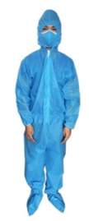
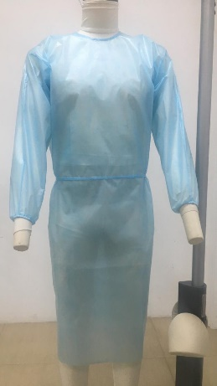
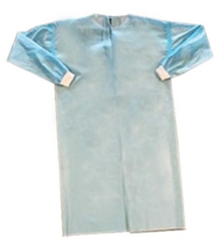
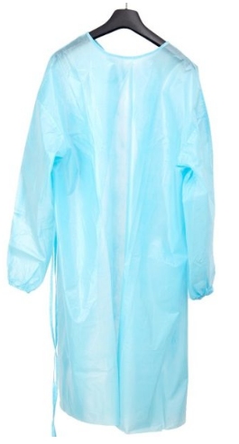
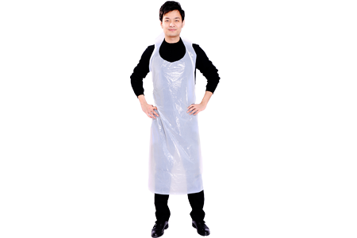
Surgical gowns, Isolation gowns & Protective suits PP – non woven fabric, disposable & bio degradable, Anti static & non linting, dust proof, antibacterial and water proof * Colours – Blue / White * Material – 35 gsm to 60 gsm PP fabric * SMS : Spun bound/melt blown/spun bound , PPPE: Polyester, Polypropylene with quoting * SIZES : M/L/XL/XXL * AAMI Level 1,2,3 * AATCC TM127-2018:>20cm H20 * AATCC TM42-2017ePB70AMI L2 Also available in PE, disposable Aprons & gowns
SUPPORT20
By Marguerite Aluwihare
Please refer individual itemized specs sheet for more information on product & pricing
Standard : EN 14126, ISO 13485:2016, ISO 9001:2015, TGA, FDA, CE, Test reports, CFS

Slide 4
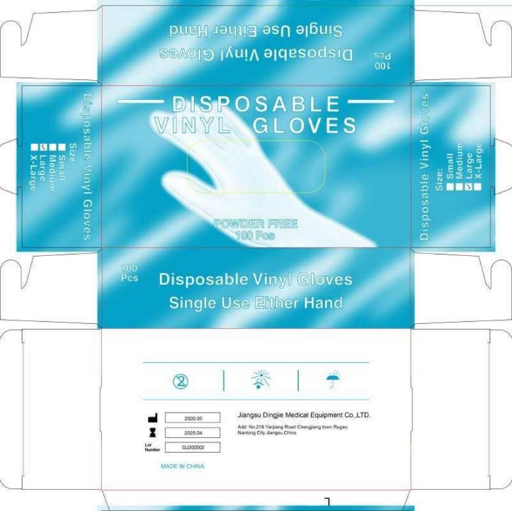
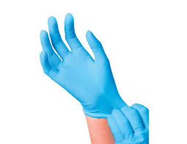
Disposable Nitrile & Vinyl Examination Gloves Nitrile * Latex free, Powder free, Non-sterile, single use * Standard length 9 inch * Sizes : XS/S/M/L/XL Vinyl – disposable powder free/powdered Latex gloves
SUPPORT20
By Marguerite Aluwihare
Please refer individual itemized specs sheet for more information on product & pricing
Standard : ISO 13485 :2016, FDA, CE, EN455 & EN 374

Slide 5
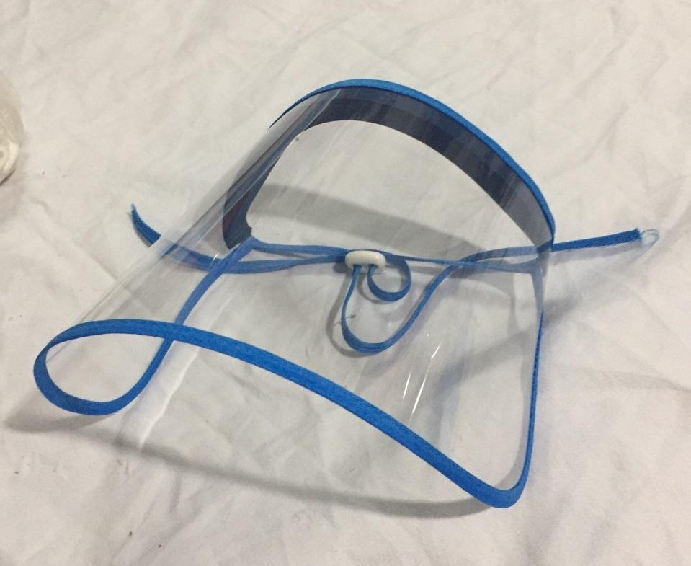
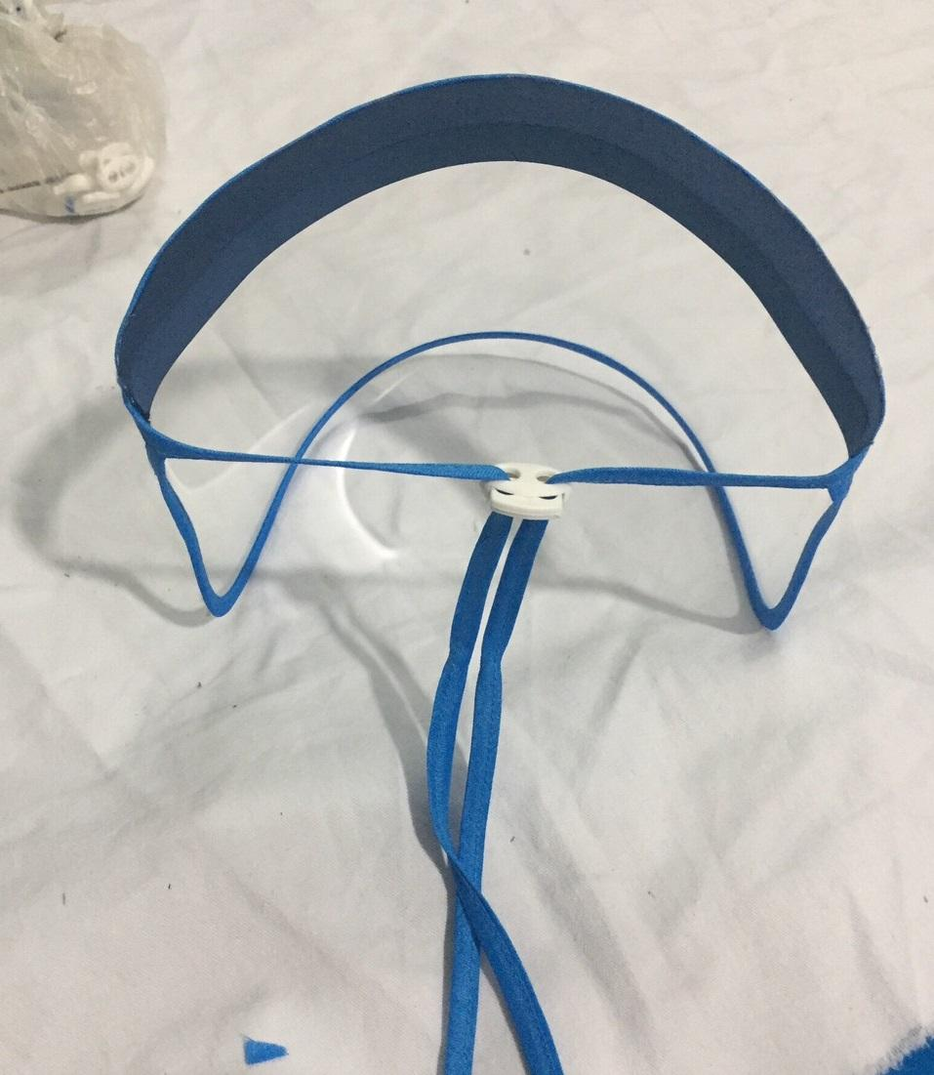
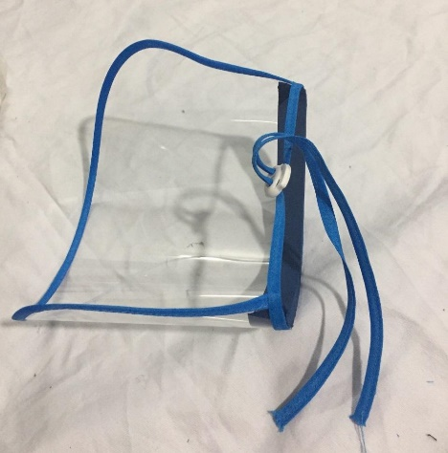
Face shields Reusable * 100% plastic * 40 pieces in box * Reusable
SUPPORT20
By Marguerite Aluwihare
Please refer individual itemized specs sheet for more information on product & pricing

Slide 6
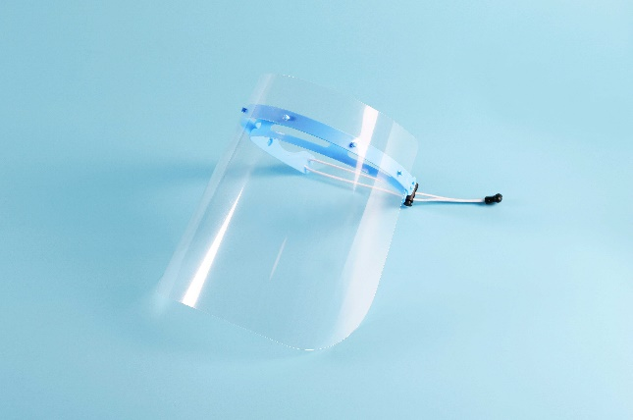
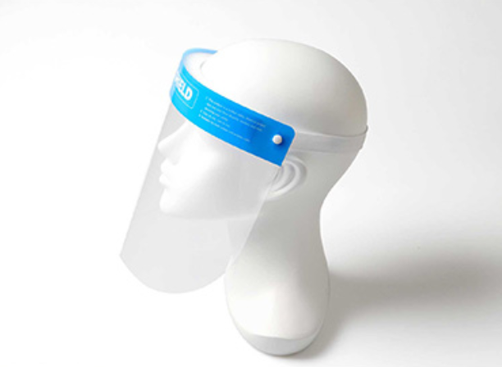
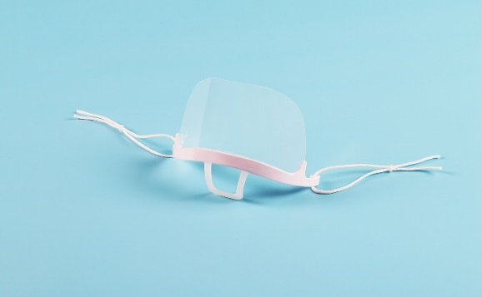
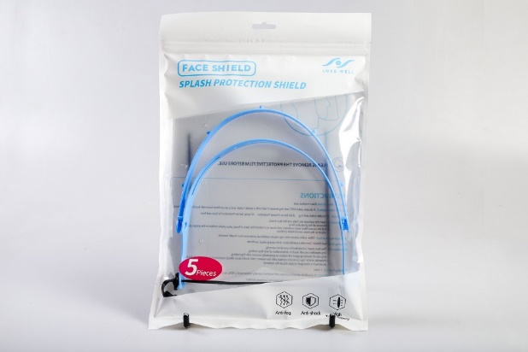
SUPPORT20
By Marguerite Aluwihare
FACE SHIELDS
Disposable face shields – Apet / Anti Fog
Adjustable Face Shield
Face Shield
Disposable Face Mask
Please refer individual itemized specs sheet for more information on product & pricing
APET 0.3mm anti-fog and ANSI / FDA approved

Slide 7
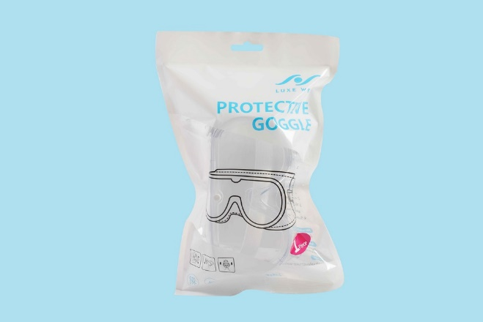
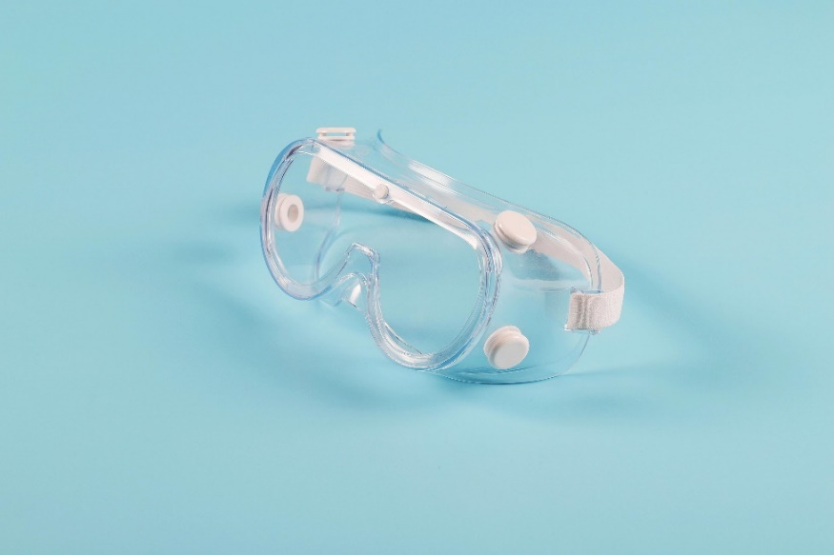
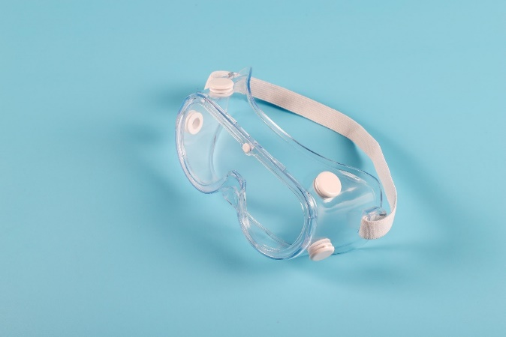
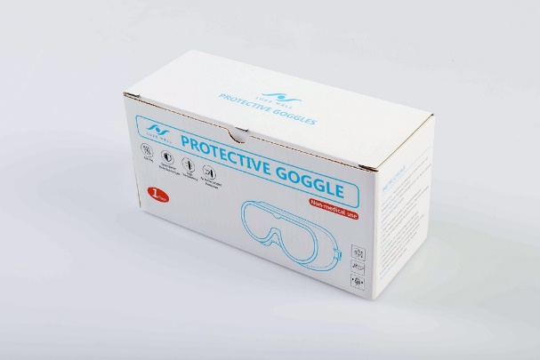
SUPPORT20
By Marguerite Aluwihare
PROTECTIVE GOGGLES
Protective Goggle
Please refer individual itemized specs sheet for more information on product & pricing
APET 0.3mm anti-fog and ANSI / FDA approved

Slide 8
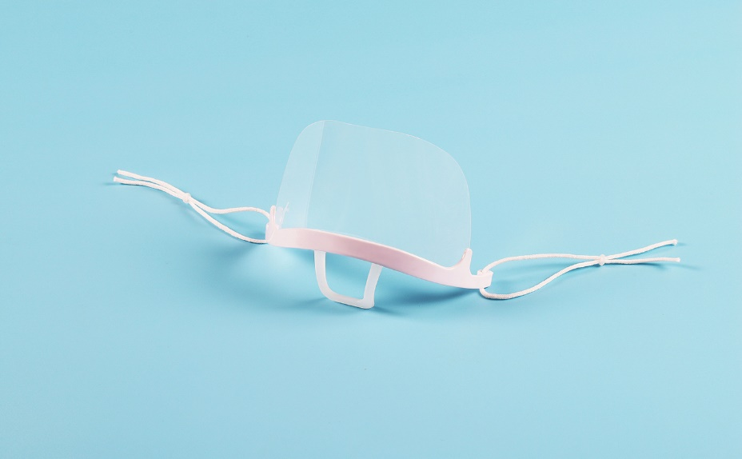
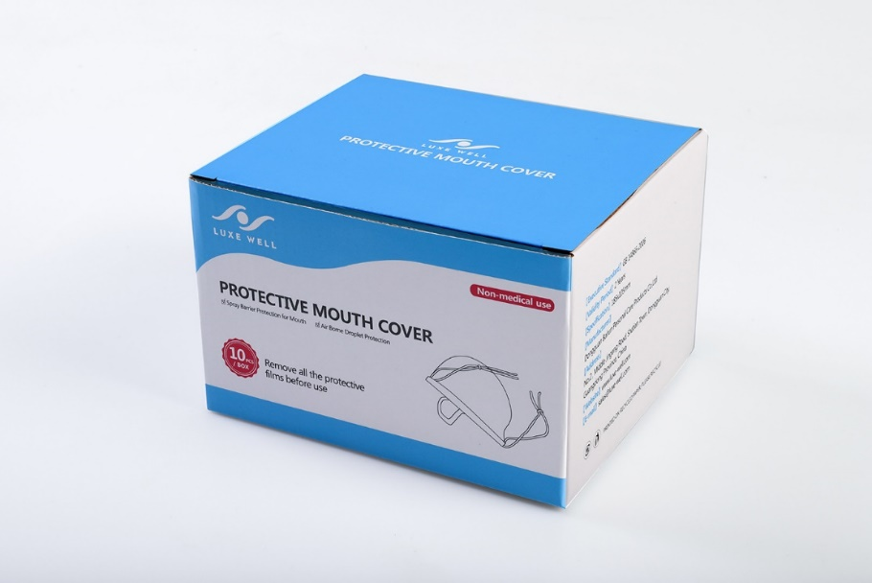
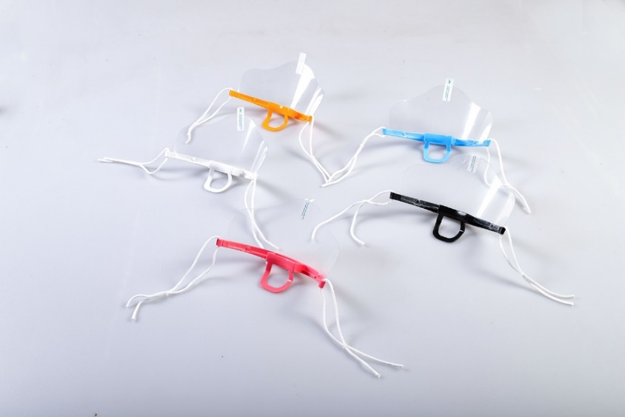
SUPPORT20
By Marguerite Aluwihare
PROTECTIVE MOUTH COVER
Please refer individual itemized specs sheet for more information on product & pricing
APET 0.3mm anti-fog and ANSI / FDA approved

Slide 9
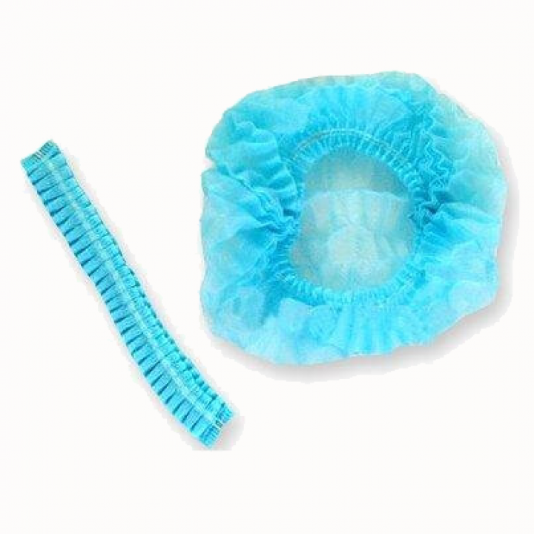
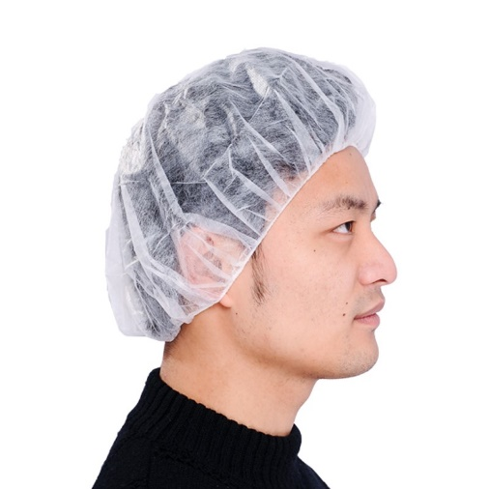
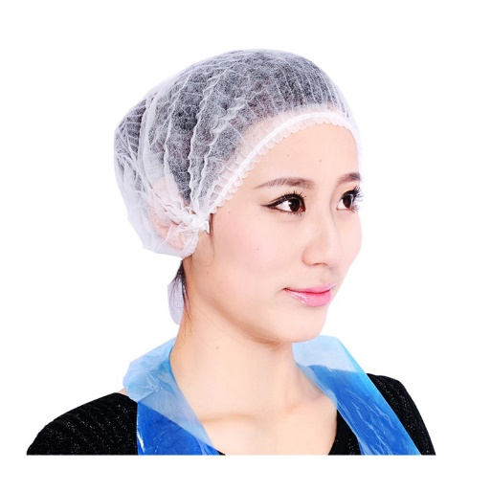
Bouffant caps in PE – Crimped Medicap in White or blue * 21 inch * 15+- 1gsm Polypropylene * I layer * Hand made or machine made
SUPPORT20
By Marguerite Aluwihare
Please refer individual itemized specs sheet for more information on product & pricing
ISO 13485

Slide 10
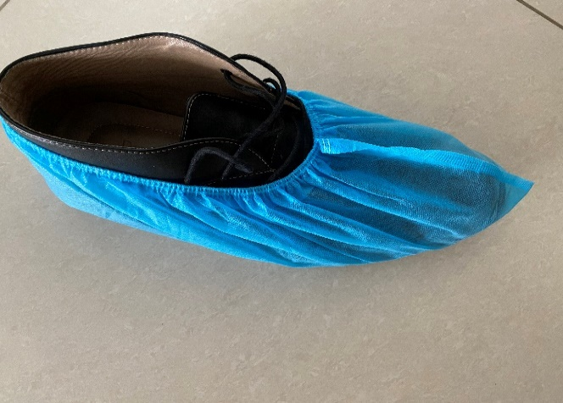
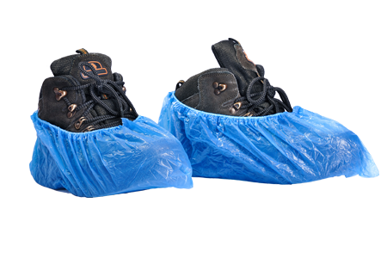
Shoe covers & boot covers In PP (Polypropylene – biodegradable) and CPE * Size 17 x 41 cm (US Size 46) & 15 x 38 cm * Available in PP blue spun bound in 30 gsm & CPE * I layer – * Machine made to the highest standards
SUPPORT20
By Marguerite Aluwihare
This is a US size 46 shoe
Please refer individual itemized specs sheet for more information on product & pricing
ISO 13485

Slide 11
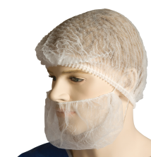
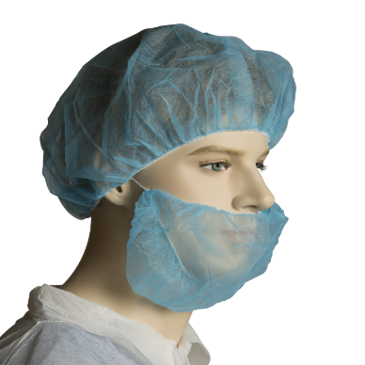
Beard covers In PP (Polypropylene – biodegradable) * 53 cm with one loop or two loops / free size white * 1 layer * Spun bound 12 +- 1 gsm * Machine made to the highest standards
SUPPORT20
By Marguerite Aluwihare
Please refer individual itemized specs sheet for more information on product & pricing
ISO 13485

Slide 12

Prices, Terms & conditions * Minimum order quantities apply – refer specs sheets. For orders below MOQ – on stock availability, orders will be processed at quickest lead times, prices negotiated and all incoterms discussed with buyer/supplier and terms agreed upon. * Shipping – by Courier/air or sea freight. If own freight forwarder unavailable, we will use ours and quote net rates obtained from shipping agent. * Prices are FOB (Vietnam), shipping/freight charges will be obtained based on order/time limitations and shipping can be handled on behalf of client * 30% payment in advance on order (Purchase order), balance 70% on dispatch with freight confirmation or LC based on order value * All certifications and approvals obtained and will be provided on request, check specs sheets
SUPPORT20
By Marguerite Aluwihare
Contact : Marguerite Aluwihare
Email – Aluwihare.margo@gmail.com/Marguerite.Aluwihare@net-glo.com
Tel : +84 933296202 / +94 776331147 (whatsapp/viber)
In partnership with : Navam Enterprise – Panjan Navaratnam
email – panjan.navam@gmail.com Tel – 61 469049451

Slide 13
Prices – FOB (Vietnam) Please refer individual specification sheet for pricing, packaging info, product information Masks Surgical, Isolation gowns and Protective suits Nitrile gloves & Vinyl Gloves Face Shields, Protective goggles and Mouth covers Bouffant caps, shoe covers & beard covers Shipping/freight charges, handling and clearing not included. Any import taxes, GST applicable receiving country not included.
SUPPORT20
By Marguerite Aluwihare
Shark building - 3rd Floor, 29 Nguyen Van Mai, Ward 8, District 3
Ho Chi Minh City, Vietnam

Slide 14

SUPPORT20
By Marguerite Aluwihare
ABOUT US
Location – Ho Chi Minh City, Vietnam
Sales & service points – Australia / Sri Lanka
ABILITY
We have a very good working relationship with manufacturers and ability to negotiate best rates for large volume, co-ordinate production deadlines, check and follow up on available stocks for urgent and small volume not meeting the minimum order quantity (MOQ), secure confirmed time lines, ensure product specifications are met and shipment is guaranteed on board vessel/freight. The ability to communicate in a timely and professional manner in clear modes of communication – English, to meet the global demands of the customers and ensure a smooth flow. Additionally, we have representation with liaison partners located in Thailand, Indonesia, Philippines, China, Malaysia and Cambodia.
THE FACTORY / SUPPLIERS
Meeting the highest standards of business practice with certifications from FDA, CE, ISO. Production capacity - large volumes of over 1000 cartons a day (2,500,000 – 4,000,000 pieces) on Masks and 100,000 pieces for surgical gowns, ability to execute large volume orders and direct shipping from factory.
SHIPPING/FREIGHT
Assist in obtaining best rates and services from courier to airfreight or sea freight – ex Ho Chi Minh City on behalf of the consignee. Ensuring all customs declarations/ documentation checks for a smooth operation. 3rd party inspections for large orders from Intertek, SGS or TUV prior to dispatch, certifying product.
Global Networking & Sourcing Solutions

